Slide 1

Shri vaishnav vidyapeeth vishwavidyalaya
Movie Recommendation System
Submitted By:
Chaitanya Mishra(18100BTCSAII02836)
Divyanshu Shrivastava(18100BTCSAII02839)
Nayanpreet Chhabra(18100BTCSAII02848)
Pragya Jain(18100BTCSAII02852)
Submitted To:
Gaurav Choudhary

Slide 2
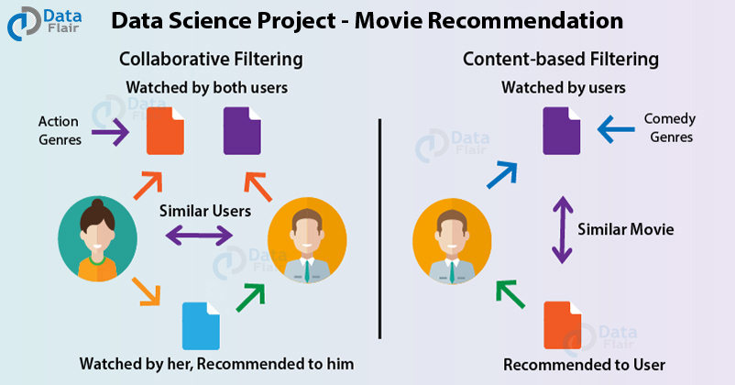
MOVIE RECOMMENDATION SYSTEM

Slide 3
Introduction
Movie popularity can help people decide which movie to watch, or whether they want to go the cinema to watch it or wait till the DVD is release and watch it at home. Consequently, it could also help theater owner to choose which movies to show or how many times to show it or for how long.

Slide 4
Dataset to be used:
MovieLens Dataset.
In order to build our recommendation system, we have used the MovieLens Dataset. We are using ”movies.csv” and “ratings.csv” files. This data consists of 105339 ratings applied over 10329 movies.

Slide 5
Problem Definition:
Its still confusing to predict the movie that to be suggested to an user to view next on the basis of previously watched movies and on the basis of the genre the user is interested in.

Slide 6
PROBLEM STATEMENT:
Generally user when first starts to watch any movie the dataset is blank. As he slowly gets indulged in further watching the dataset gradually gets updated with his/her watched movies and concludes with the movie genres.
The most popular movie present in the current dataset of the same genre should be the next suggestion.
This should be done to know the popularity of a movie amongst the users having interest in same genre.
Our task is to suggest the next movie on the basis of user interest and ratings given by the users having same interest.

Slide 7
Purpose:
The purpose of this project is to analysis a dataset containing information about movies and ratings given by the user.
a dataset ”movies.csv” used to have the alphabetically arranged movie list on the basis of genre.
a ”ratings.csv” that explains how much popularity a movie has amongst the users.

Slide 8
Technology being used:
R programming language.
IDE- Rstudio

Slide 9
Outcome:
This project will provide proper list of recommended movies for a certain user according to his interest in previously watched movies.
Also the ratings by the other users will contribute to do the same.
It will also help to judge the popularity of a particular movie amongst the users in different genres.

Slide 10
THANK YOU

